Slide 1




BLIND WALKING STICK
Circuit and System-I Lab Project
BY:
Ali Asghar (21PWCSE2059)
Suleman Shah (21PWCSE1983)
Shahzad Bangash (21PWCSE1980)

Slide 2


INTRODUCTION:
Around 36 million of people were said to be blind in 2015.
Since Blind people can not see and walk by themselves alone and they fear hurting themselves during walking, that is why they need someone to show them their way while they walk outside but that is not possible having someone always around them showing them their way.
Therefore, the objective of this project is to help these blind people so that they do not need someone always present at the movement for helping them to show them their way, this project hopefully will make them independent while they go for short walk.
To avoid danger, the buzzer will give them alarming beep when something is in front of them.

Slide 3




COMPONENTS USED:
The components which we have used in our project are:
Arduino UNO Board
HC SR04 Ultrasonic Sensor
Active Buzzer
9 Volt Battery
Connecting wires
Stick

Slide 4
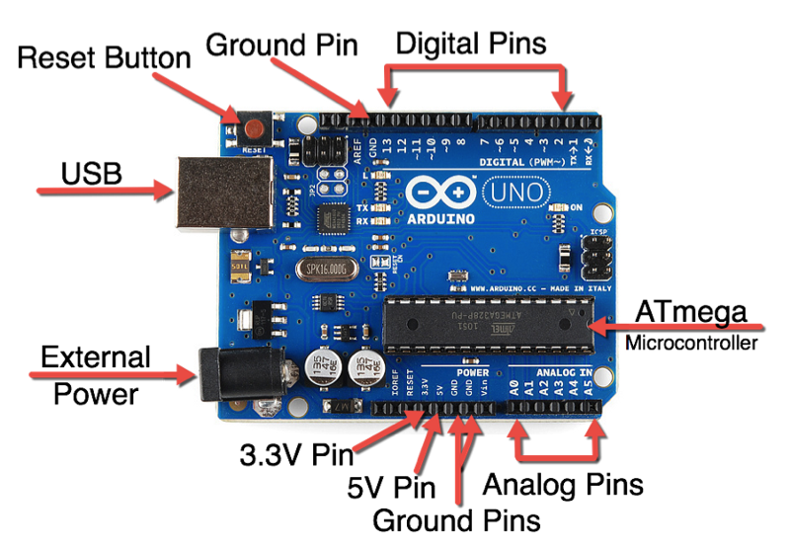
COMPONENTS USED:
Arduino is a microcontroller used to control and integrate electronic components with each other. It is used in many electronic projects. The Arduino consists of Analog and Digital I/O pins and some other pins as shown in the figure.
Simple C or C++ language is used to write the code for the projects and with the help of Arduino IDE, the code is then uploaded to the Arduino microcontroller through a USB Plug as shown in the figure.
After the code is uploaded to Arduino, we can also run it with a 9V battery.

Slide 5
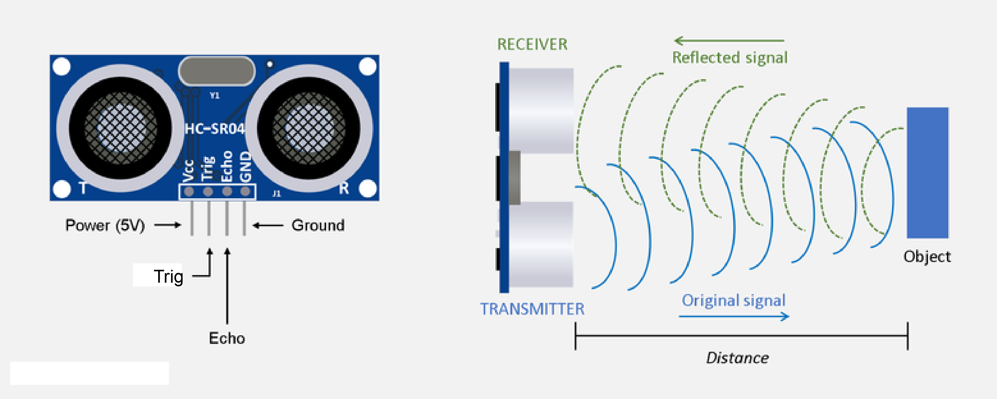
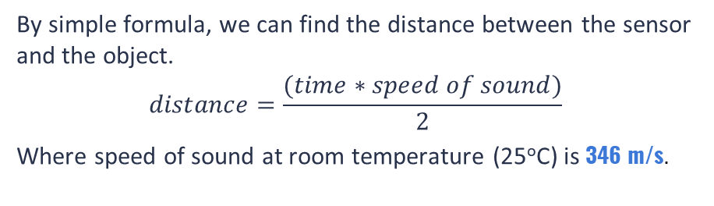
COMPONENTS USED (CONT.):
The 2 pins, trig and echo, are the pins required to generate ultrasonic waves.
This sensor’s working principle is that when the trig pin becomes high the transmitter module generate and transmit the ultrasonic waves. Simultaneously the echo pin becomes high too. Now when the waves reflect back by striking an object in front of it, the receiver module receives the reflected waves and at the same time, the echo pin becomes low. Hence the time interval at which the echo pin remained high is the total time taken by the waves.
By simple formula, we can find the distance between the sensor and the object.
$$distance=\frac{(time∗speed of sound)}{2}$$
Where speed of sound at room temperature (25ºC) is 346 m/s.

Slide 6
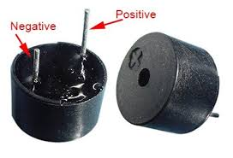
COMPONENTS USED (CONT.):
This is an active buzzer which means it directly produces sound as soon as it gets the required DC voltage mostly 3.5V – 5.0V.
It is used in timers, alarm devices, computers, etc.

Slide 7
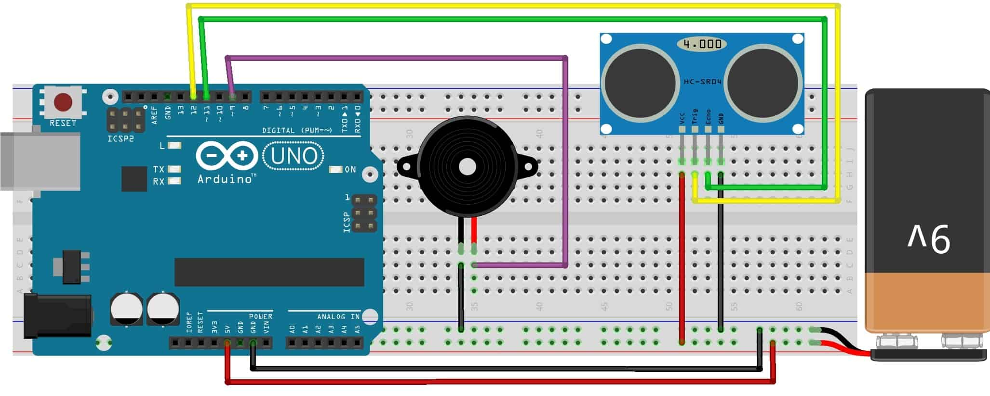
OUR PROJECT CIRCUIT DIAGRAM:
9V

Slide 8
CIRCUIT CONNECTIONS:
Vcc pin of ultrasonic sensor is connected to 5 volt pin of Arduino.
Trigger pin of ultrasonic sensor is connected to D12 pin of Arduino.
The ground of ultrasonic sensor is connected to the GND pin of Arduino.
The positive terminal of the 9-volt battery is connected to the Vin pin of Arduino and the negative terminal is connected to the GND pin of Arduino.
Echo pin of ultrasonic sensor is connected to D11 pin of Arduino.
A buzzer is connected between the D4 pin of Arduino and the GND pin.

Slide 9
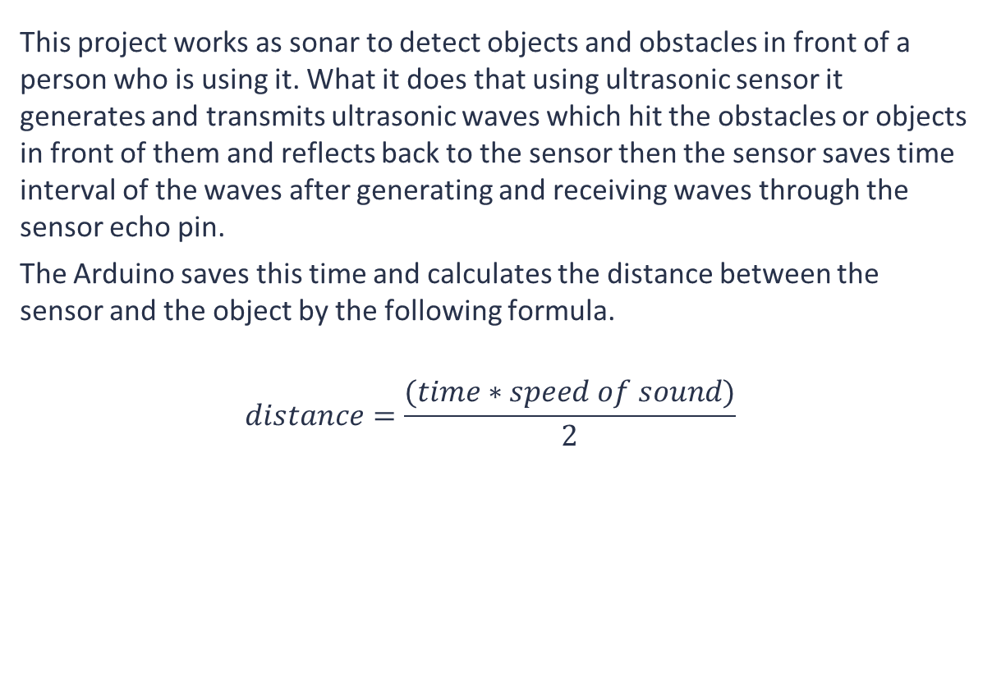
PROJECT WORKING PRINCIPLE:
This project works as sonar to detect objects and obstacles in front of a person who is using it. What it does that using ultrasonic sensor it generates and transmits ultrasonic waves which hit the obstacles or objects in front of them and reflects back to the sensor then the sensor saves time interval of the waves after generating and receiving waves through the sensor echo pin.
The Arduino saves this time and calculates the distance between the sensor and the object by the following formula.
$$distance=\frac{(time∗speed of sound)}{2}$$
The beeping sound of buzzer changes with the distance between the ultrasonic sensor and the obstacles. The closer the distance the more will be the buzzer beep frequency.

Slide 10
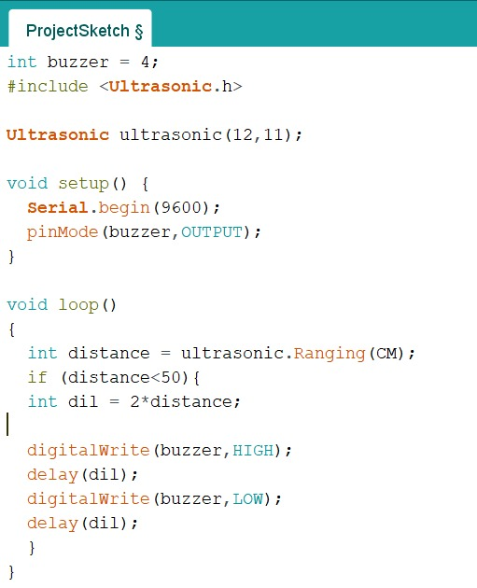
CODE SCREENSHOT:

Slide 11
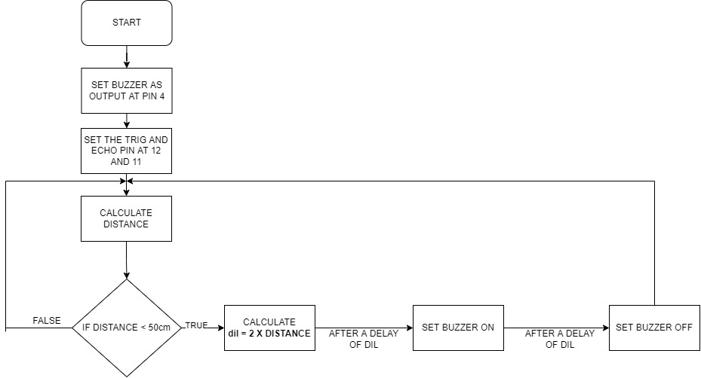
CODE FLOW CHART:

Slide 12
THANK YOU

